Slide 1
Enterprise Software Life-cycle Support System
Software Factory NTI
Mike O’Brien, Toby Hable
May 2014

Slide 2
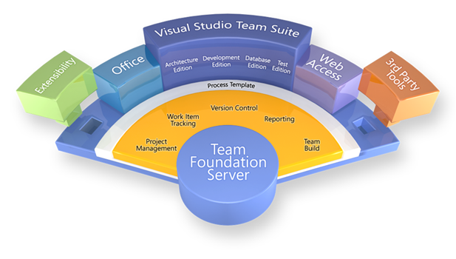
NTI-Core: Software Life-cycle Support System
Technology:
Establish a Software Life-cycle Support System (SLSS) by leveraging Microsoft Team Foundation Server (TFS).
Objectives:
Create System Architecture candidate
Determine estimated cost of deployment and service
Draft Service Level Agreement (SLA)
Determine interest of other divisions
Businesses – HISD, TSSD, IPD
Status: NTI – Core Initiation into Pre-NTI
Resources:
1.25 FTE for
Mike O’Brien 1.0 FTE
Phil Savoie 0.25 FTE
Dave Schaller – HISD
Scott Howard – HISD
Total funding request $50 K
Key SEMS Contact: Mike O’Brien

Slide 3
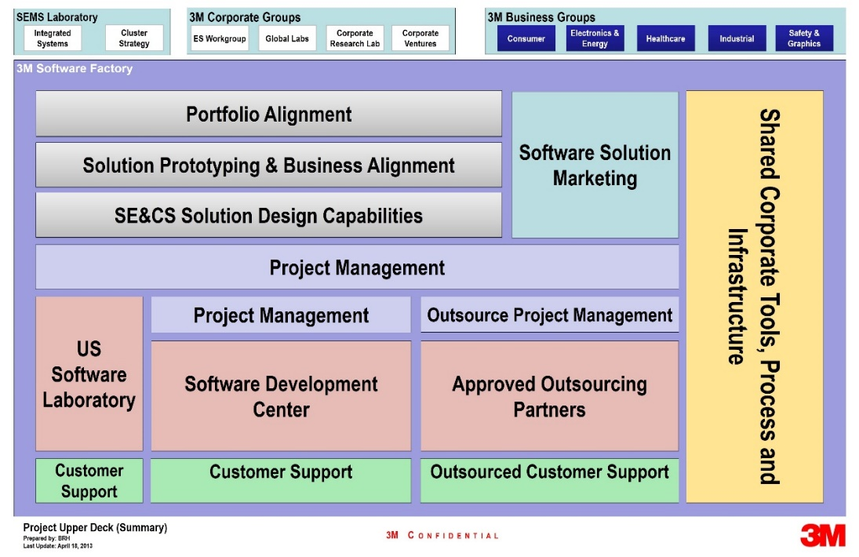












3M Software Factory – Software Engineering for the Future
Building the software engineering capabilities needed to enable rapid, high-quality and profitable product development.
Specialized Software Skillsets
Software Process Development
State of the Art Software Infrastructure
Divisions + ES Workgroup

Slide 4
NPI – Enterprise Infrastructure Analogy
Idea
Concept
Feasibility
Dev’t
Scale Up
Launch
Post Launch
Division A
Commercialization Process
Division B
Commercialization Process
Division C
Commercialization Process
Divisions Implement to business needs
eNPI Project Management Database
Single Corporate Tool for Managing the Portfolio
Notes:
current NPI process is high level
Implemented by divisions based on needs

Slide 5
Software Life-cycle Support System – Enterprise Software Infrastructure
Idea
Concept
Feasibility
Dev’t
Scale Up
Launch
Post Launch
Division A
Software Process
Division B Software Process
Division C Software Process
Divisions establish software process based on business needs.
Software Life-cycle Support System (SLSS) using Microsoft TFS
NTI Goal
Notes:
current NPI process is high level
Implemented by divisions based on needs

Slide 6




Software Life-cycle Support System – Leveraging TFS
Tools
HISD Process
SEMS Process
Division Process …
Defined Processes
Software Life-cycle Support System (SLSS) using Microsoft TFS
Process Template
TFS Technology
Platform
Project Management
Requirements Management
Version Control
Test Case Management
Build Automation
Reporting
Notes:
Team Foundation Server (TFS) is the collaboration platform at the core of Microsoft's application lifecycle management (ALM) solution. TFS supports agile development practices, multiple IDEs and platforms locally or in the cloud and gives you the tools you need to effectively manage software development projects throughout the application lifecycle.
TFS supports the defined process– both the enterprise development process, and division implementations

Slide 7
Why does 3M need a Software Life-cycle Support System?
Independent work groups with differing tools
Broad range of tools – shallow or ‘silo’ed’ expertise
Tools not integrated, i.e., No Start-to-End visibility
Lack of common infrastructure
Build each solution independently
Little or no reuse of solutions across groups/divisions/company
Redundancy of personnel
Underutilization of technology

Slide 8
ETFS – Systems Consolidation
TFS
Rational
Notes:
Divisions with resources needed to support infrastructure
As Divisions move to ETFS, resources are freed up to develop

Slide 9
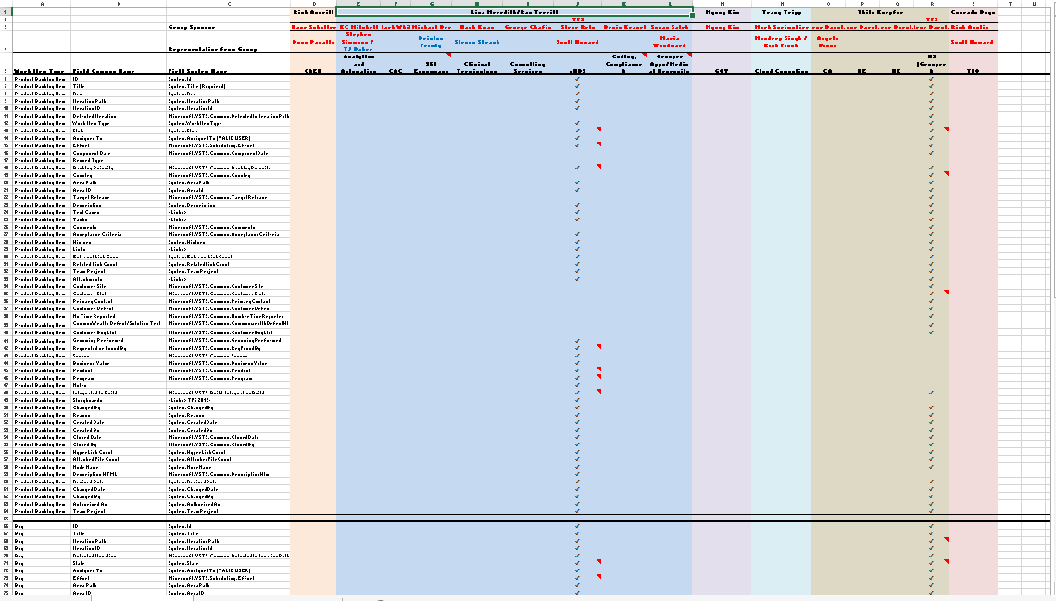
HISD – Case Study within 3M
HISD currently consolidating development systems to:
Improve communications – “One source of truth”
Aid in defining development process
Reduce infrastructure support
Utilize tools effectively
“This is the Polaris Project for HISD”
Notes:
Integrating 5 TFS servers (potentially 6-10)
Secondary phase – migrate non-TFS system into same system

Slide 10
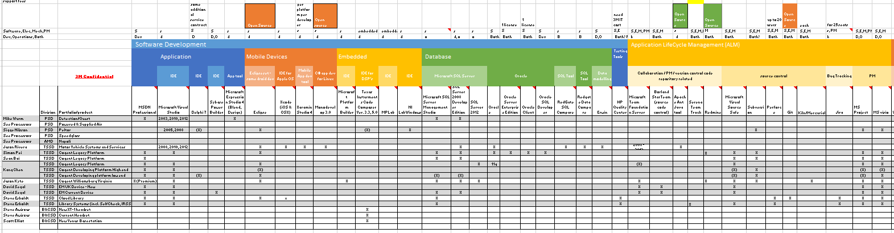
TSSD – Case Study within 3M
Toby Hable and Mike O’Brien participated in a high level analysis of ES tools in use – below is a high level spreadsheet view
Conclusions:
Wide range of tools
Shallow and/or “silo’d” use
Common Commercialization Process and Tools would provide high value
Notes:
Larry Ps

Slide 11
Current and Potential Division Users
Current – on the SEMS TFS Server:
SEMS, CRPL, CRAL
ESPE, DOC, Unitek
TSSD (SSD), AAD, RED, SOSD
IT (MES), Corporate Security
Potential:
HISD
TSSD, IPD, IT (Mobile)

Slide 12
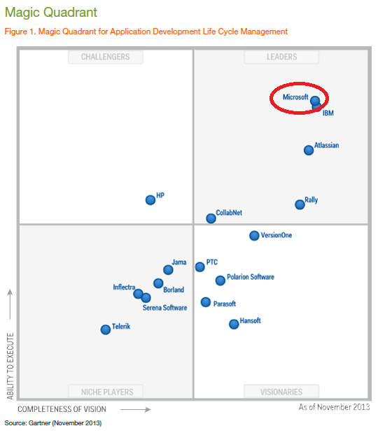






Why TFS?
Notes:
Magic Quadrant from TFS 2012
Large companies = US Bank, Target, Boeing, Dell, HP
TFS - market leader
In use widespread use within 3M
SEMS active user since 2006 – initial version of TFS
In use by other large companies for Enterprise wide use

Slide 13
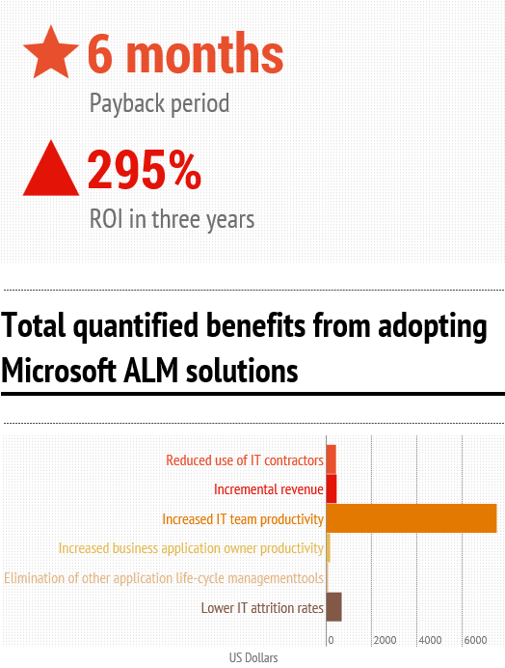
Benefits of Enterprise TFS Solution
Centralized Repository
High Availability
Improved Disaster Recovery
Increased collaboration/sharing
Reduced cost
Support Specialists – customization, maintenance and support
Visibility – customized Key Performance Indicators (KPI’s)
Training – increased knowledge of capabilities
Infography created by InCycle Software
Source information from Forrester: The Total, Economic Impact of Microsoft Application Life Cycle Mangement
Notes:
Dell case study – ROI: 225% Payback: 6 months
CollabNet case study: ROI 225% Payback: 12 months
Key benefits from case studies?

Slide 14
Project Deliverables – Pre-NTI
We are ready to enter Explore when we have:
System Requirements
Definition of the Service
Draft of ‘Cost of Service’
Engaged additional candidate Divisions
System Architecture
Draft of Service Level Agreement (SLA)
CTOC Presentation

Slide 15
Long Term Plan
In Explore we plan to:
Implement the Service
Run Pilot by On boarding specific HISD & SEMS development teams with existing TFS servers
Qualify
Expand to include other HIS teams (non-TFS)
On board SEMS teams/divisions from our server
Deploy
On board additional teams corporate wide

Slide 16
Milestone Timeline by Phase
Assess Needs
Define Enterprise Architecture
Define Service / Capabilities
Implementation and Pilot with HISD
Offer Service Extend Offering
Expand Onboarding with HISD Teams
Pre-NTI
Explore
Qualify
Deploy
May 2014
July 2014
Sept 2014
Dec 2014
Notes:
Could add timeframes here instead of dates - ?
Consolidate Pre-NTI milestones - ?

Slide 17
Proposed Resources
Resource – Total 1.25 FTE
Mike O’Brien – 1.0 FTE
Phil Savoie – 0.25 FTE
HISD Resources
Dave Schaller
Scott Howard
Consultants
Microsoft Consulting Services (MCS) – Currently engaged with HISD to assess and recommend a TFS strategy and architecture
Don Carlson

Slide 18
Thank You
Q&A

Slide 19
Major Components of a System Candidate Architecture
Deployment location - Cloud vs. 3M Data Center
Level of Service – SOP for maintenance, support, backup, data retention
Upgrade Path - SOP for upgrades
Hardware Needs
High Availability
Scales to peak system usage
Software / Licensing
Notes:
These are the major components that need to be planned for a Candidate Architecture. Multiple Candidate architectures may be generated (one for Cloud, one for Onsite in the 3M Data Center, and perhaps one for a Hybrid between the Cloud and On-premise)

Slide 20
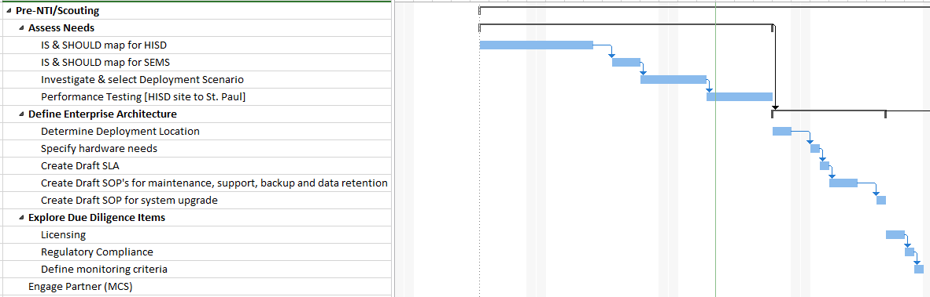
Pre-NTI Milestone Timeline

Slide 21
Project Scope and Objectives
Implement an Enterprise Team Foundation Server providing:
Project Management
Requirements Management
Version Control
Test Case Management
Build Automation
Reporting

Slide 22
Technology Platform and Roadmap
Requirements
Authoring Requirements document with Enterprise defined structure, methodology, and process
Cloud Hybridization
Cross Platform Builds
(iOS / Xamarian / Android / Linux)
Rollup Reporting
(self-service reporting portal)
Value Added
DevOps
Automated build, deploy and testing harnesses
Enterprise Software Development Process
Process Template
Project Management
Requirements Management
Version Control
Test Case Management
Build Automation
Reporting
TFS Technology
Platform
TFS

Slide 23
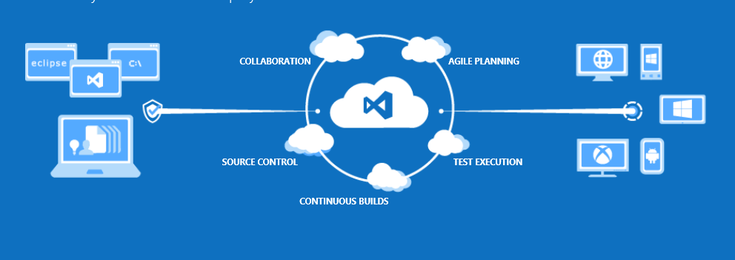
What is Team Foundation Server (TFS)?
Visual Studio Team Foundation Server 2012 (TFS) is a collaboration platform that facilitates an application lifecycle management (ALM) solution.

Slide 24
Project Milestones - Explore
Gather & prioritize requirements from candidate Divisions and Teams
Determine system interaction mechanism (self serve vs. support team interaction)
Define Migration method/process for Team Projects
Define Cost for usage – explore several models of chargeback
Determine Support and Solution Team size and skillset required
Define supported Process Template(s)
Perform trial migration of SEMS Team Projects
Define PROD architecture
Time Frame: May - August

Slide 25
Project Milestones – Qualify & Deploy
Qualify (August – Dec)
Create Training material
Develop solutions for customer interaction with system
Deploy QA & PROD instances
Initiate migration of HISD Team Projects to QA/PROD instances [“Go Live” with HISD]
Complete migration of all HISD Teams
Deploy
“Go Live” with Enterprise TFS service to other divisions

